Slide 1
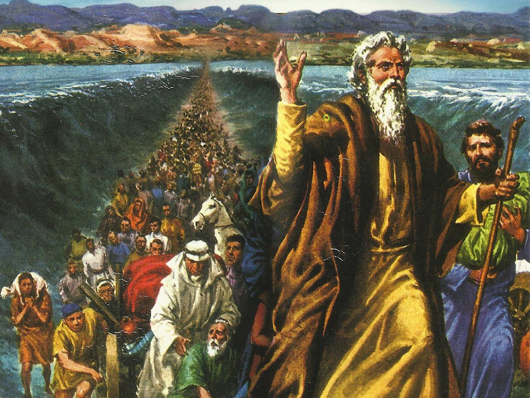
CATECHETICAL TEXTBOOK SERIES OF THE SYRO - MALABAR CHURCH
ON THE PATH OF SALVATION - 5
PEOPLE WHO AWAITED THE REDEEMER
5

Slide 2
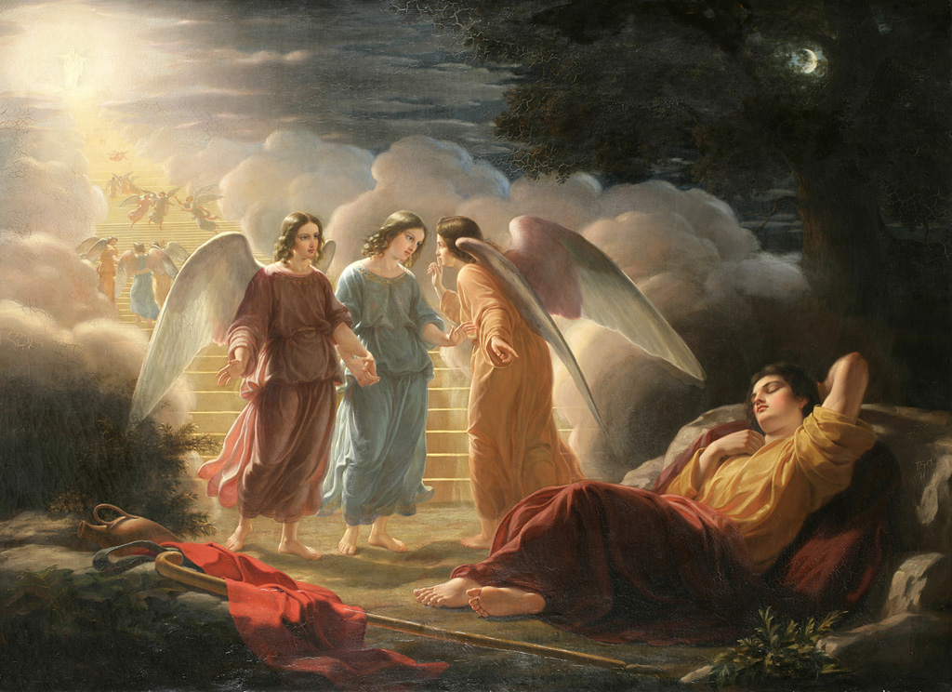
LESSON 3
THE CHOICE OF ISRAEL

Slide 3
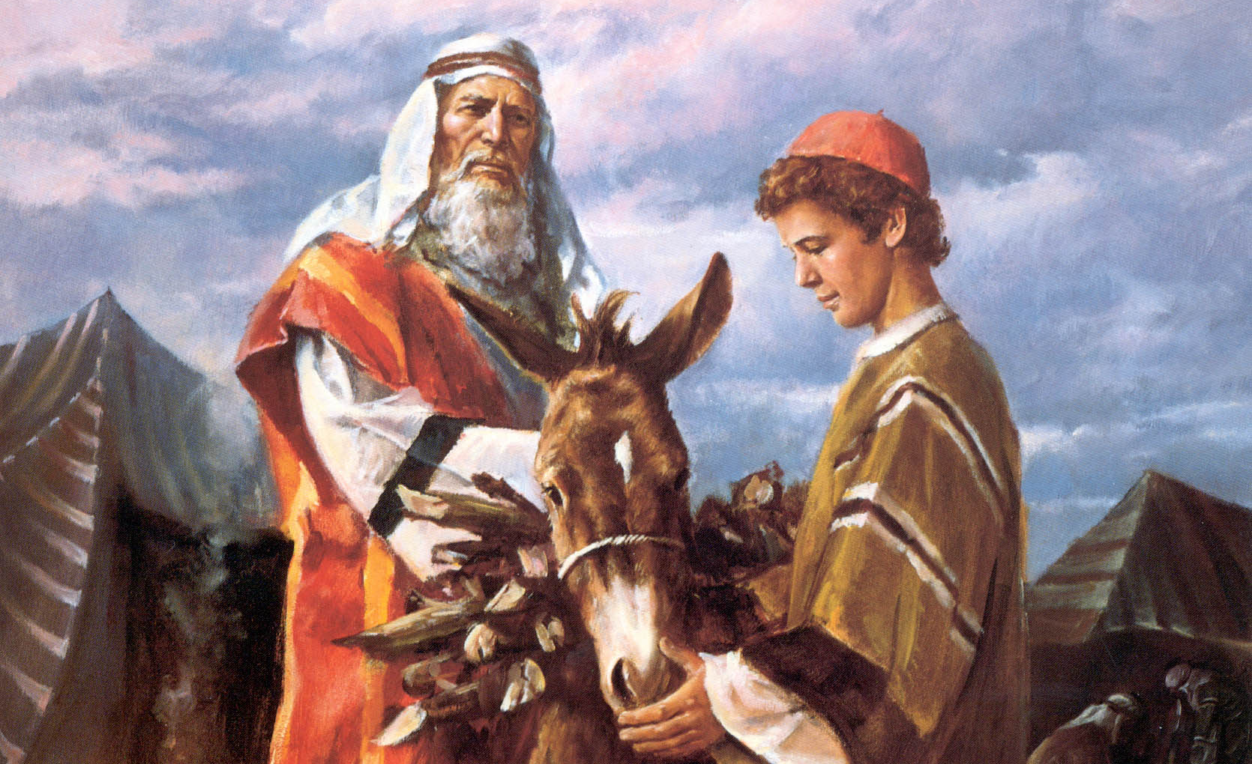
Isaac was the son born to Abraham according to the promise of God. God said to Isaac:
“ I will fulfill the oath that I swore to your father Abraham. I will make your offspring as numerous as the stars of haeaven, and I will give your offspring all these lands, and all the nations of the earth shall gain blessing for themselves through your offspring” (Gen. 26:6-4).

Slide 4
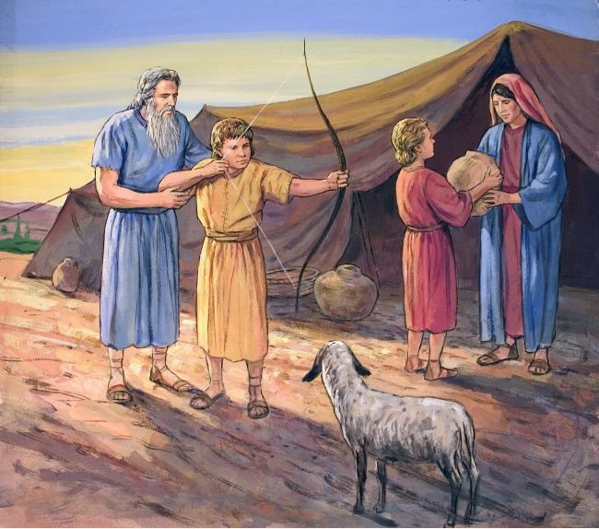
Esau and jacob
Rebekah was the wife of Isaac. She gave birth to twin boys Esau and Jacob. Esau was the elder and Jacob the Younger. Before they were born the Lord said to Rebekah:
“ Two nations are in your womb, and two peoples born of you shall be divided; the one shall stronger than the other, the elder shall serve the younger (Gen. 25:23).

Slide 5
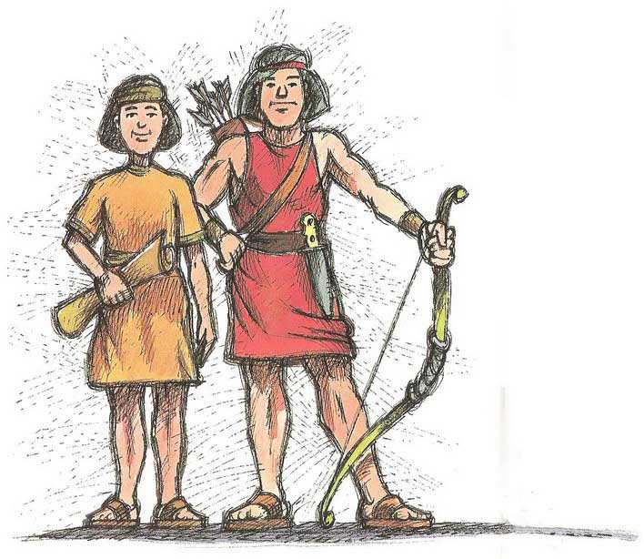
The boys grew up. Esau was a skillful hunter and a man of the field. While Jacob was a quiet man, living in tents. Isaac loved Esau because he was fond of game meat but Rebekah loved Jacob.

Slide 6
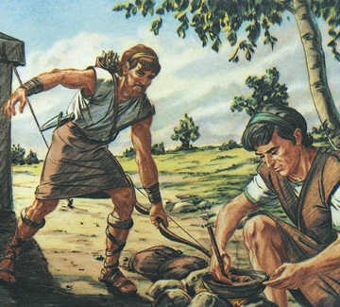
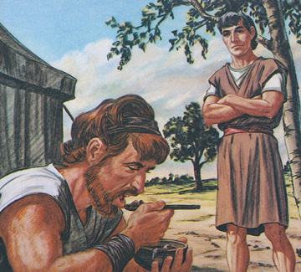
birthright
Jacob demanded Esau’s birthright in exchange for food. Feeling that, in his famished condition, food was more important than birthright, Esau sold his birthright to Jacob for bread and stew.

Slide 7
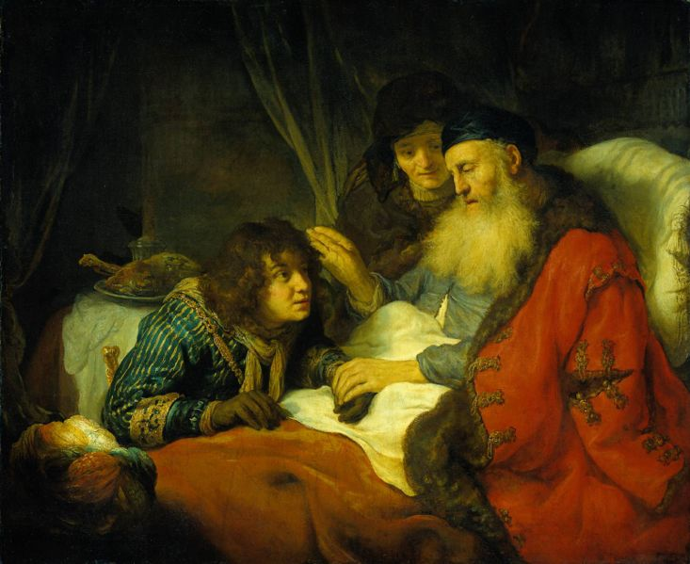
Isaac blesses jacob
“ My son, I am; I do not know the day of my death. New then take your weapons, your bow and arrows, and go out into the field and hunt game for me. Then prepare a tasty food, such as I like, and bring it to me to eat, so that I my bless you before I die” (Gen. 27: 1-4).

Slide 8
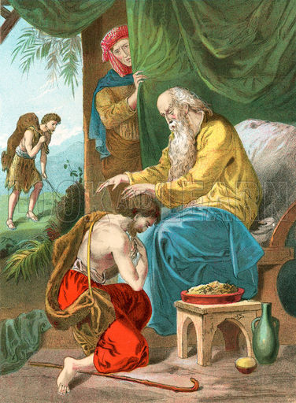
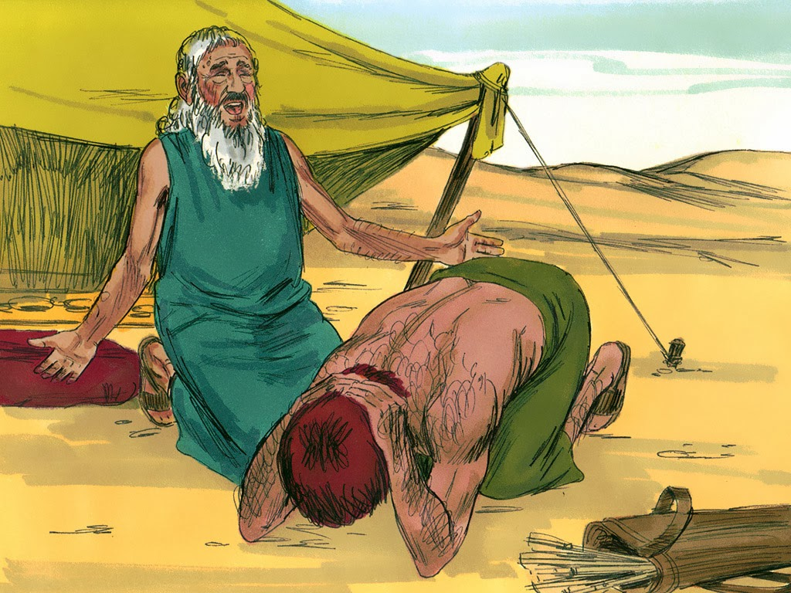
She wanted Jacob, her favorite, to obtain the blessing of his father, because the words of the Lord during her pregnancy were still in her mid.
After offering the food to Isaac Jacob asked for his blessing. Isaac gave his blessing to Jacob, mistaking him for Esau.
He told Esau that since he had already given his blessing to his brother, he should remain blessed.

Slide 9
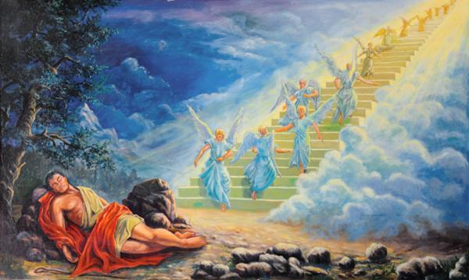
Jacob’s dream
“ I am the Lord, God of your father Abraham and the God of Isaac. I will give the land on which you lie to you and your offspring……… All the families of the earth shall be blessed in you and in your offspring. Know that I am with you and will protect you wherever you go” (Gen. 28: 13-15).
Bethel, meaning ‘the house of God’.

Slide 10
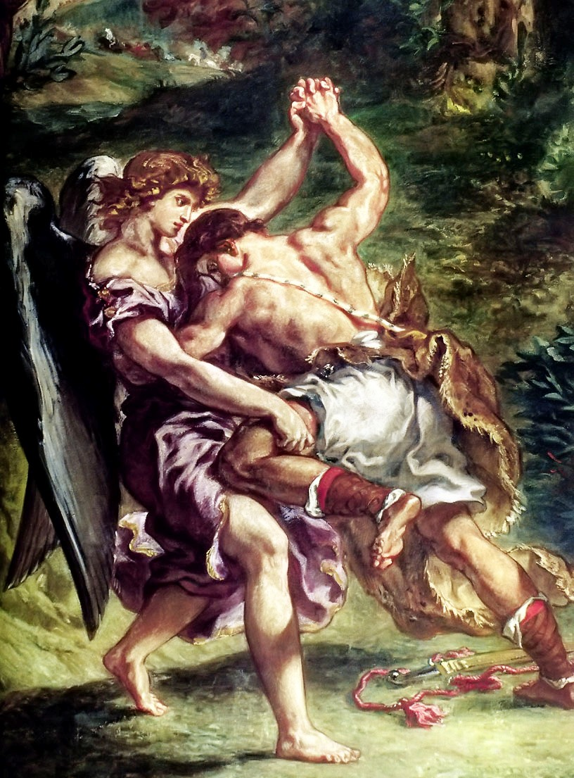
The name israel
“ Unless you give me your blessing I wont let you go”. Then he asked: “ What is your name?” “ Jacob”, he replied. Then he said: “ Hereafter you shall be called Israel and not Jacob; because you have wrestled with God and man and have come out winner”. (Gen. 32: 24-28).
Israel means ‘onewho wrestles with God’

Slide 11
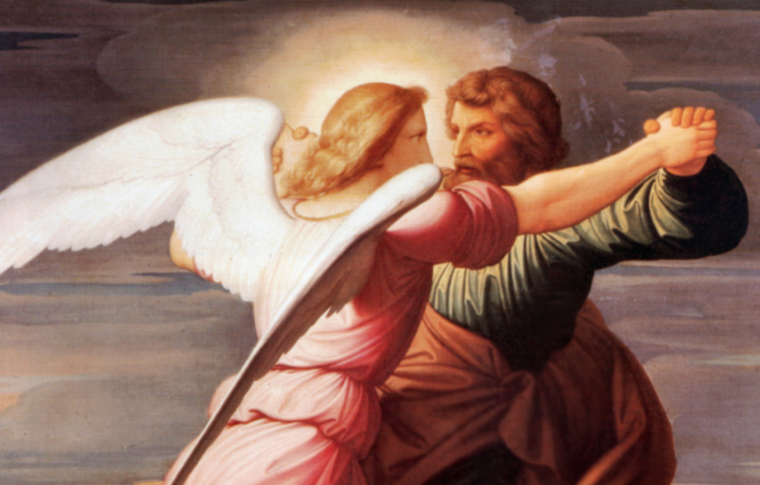
God of jacob
Then we, who are the new Israel, would receive the blessing of God just as the old Israel did. Thus the God – experience of Jacob becomes ours also.
The life of Jacob teaches us that in the God’s paln what may look evil to our human eye an turn out to our good.

Slide 12
Let us pray
Almighty God, help us to live with hope in the midst
Of our failures and difficulties.

Slide 13
READ AND RECOUNT
Narrate how Esau lost his birthright
(Gen.25:27-34)

Slide 14

WORD OF GOD FOR GUIDANCE
Know that I am with you and will keep you
Wherever you go (Gen.28:15).

Slide 15
MY DECISION
I will not forfeit my divine sonship for the sake
Of temporal gains.

Slide 16
LET US DO
Match the following drawing lines
Israel
Stream
Bethel
One who wrestles with God
Yabok
House of God
Issac
Birthright
Esau
Father of Jacob

Slide 17
LET US FIND OUT THE ANSWER
1. How did Esau lose his birthright?
2. What did Issac say when he blessed Jacob?
3. What is the meaning of the word Bethel?
4. What is the name Jacob received after wrestling with God?
5. What does the life of Jacob teach us?

Slide 18
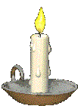


Thank you

